Slide 1

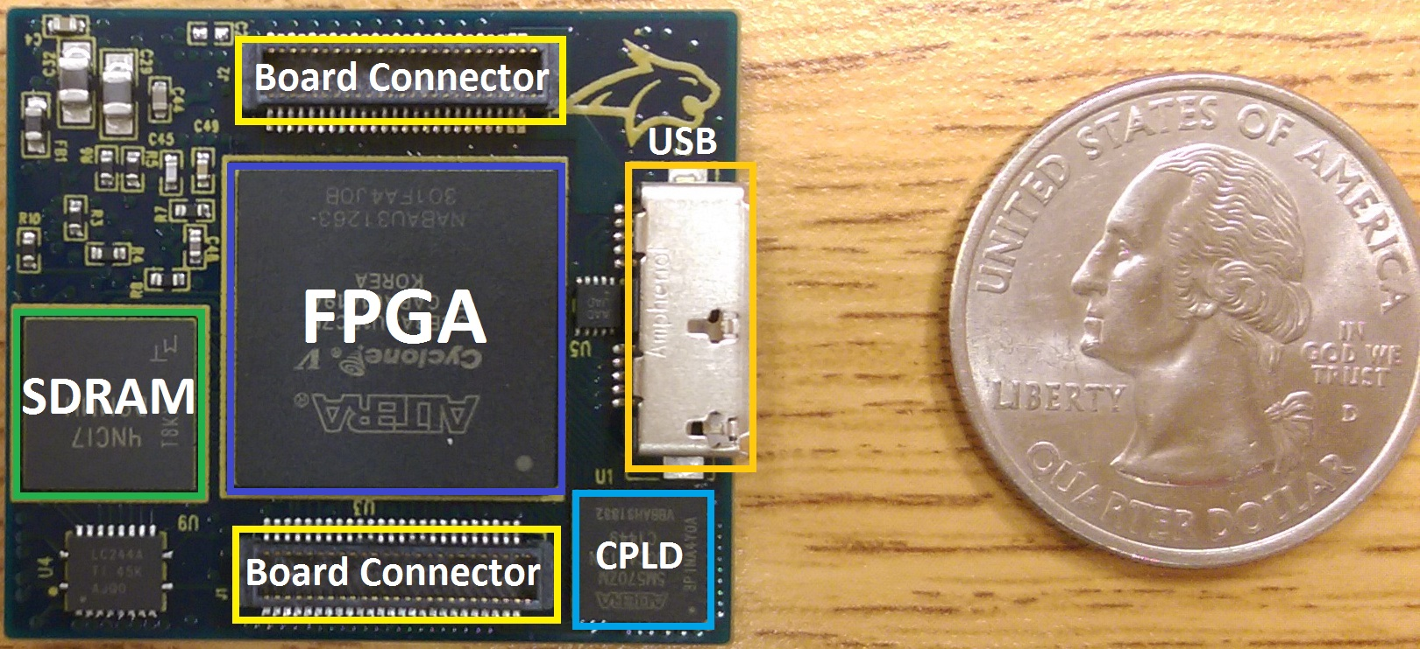
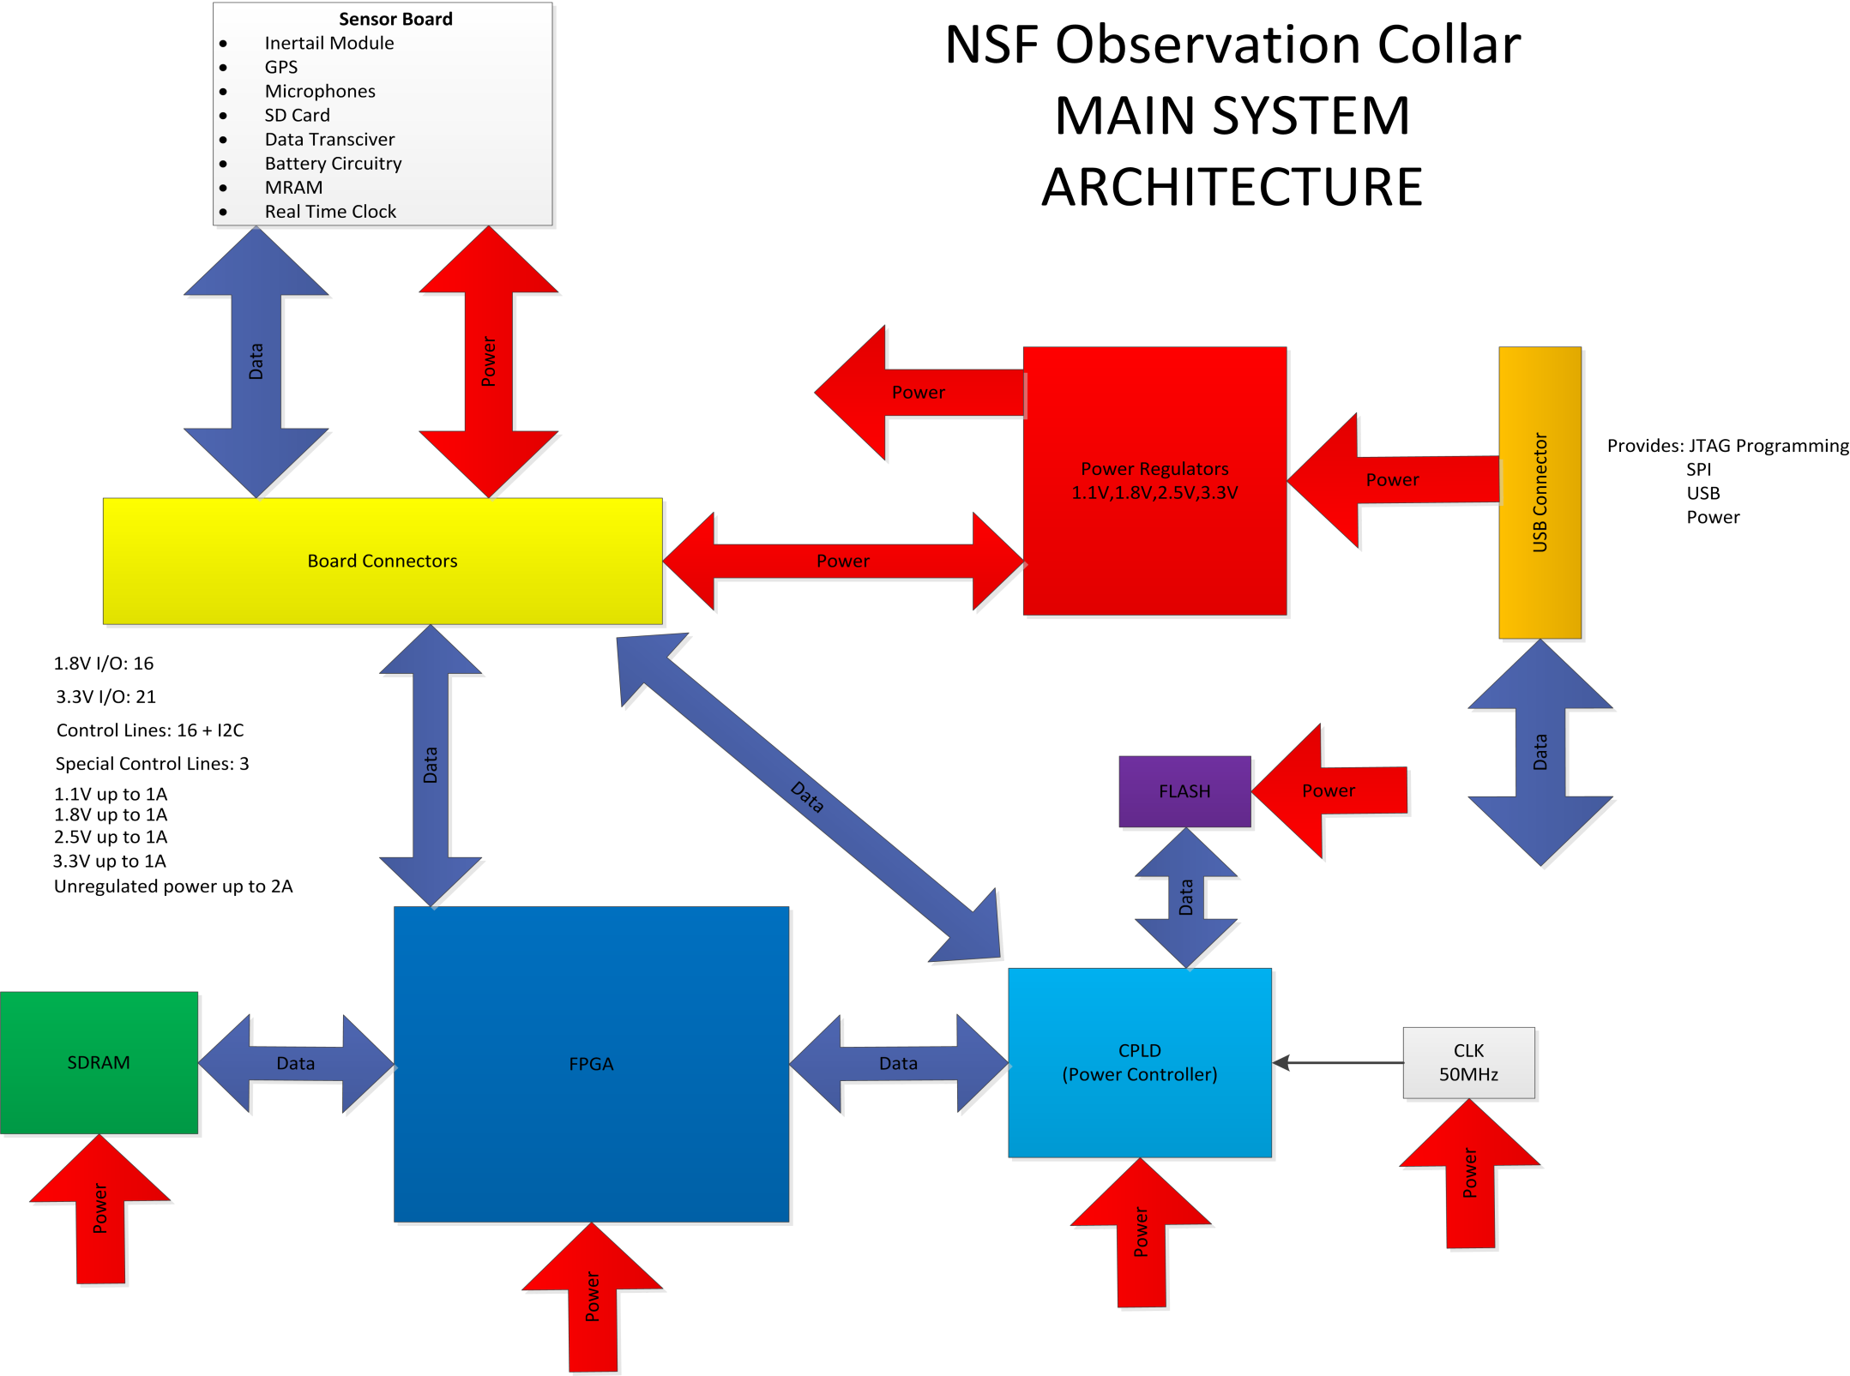
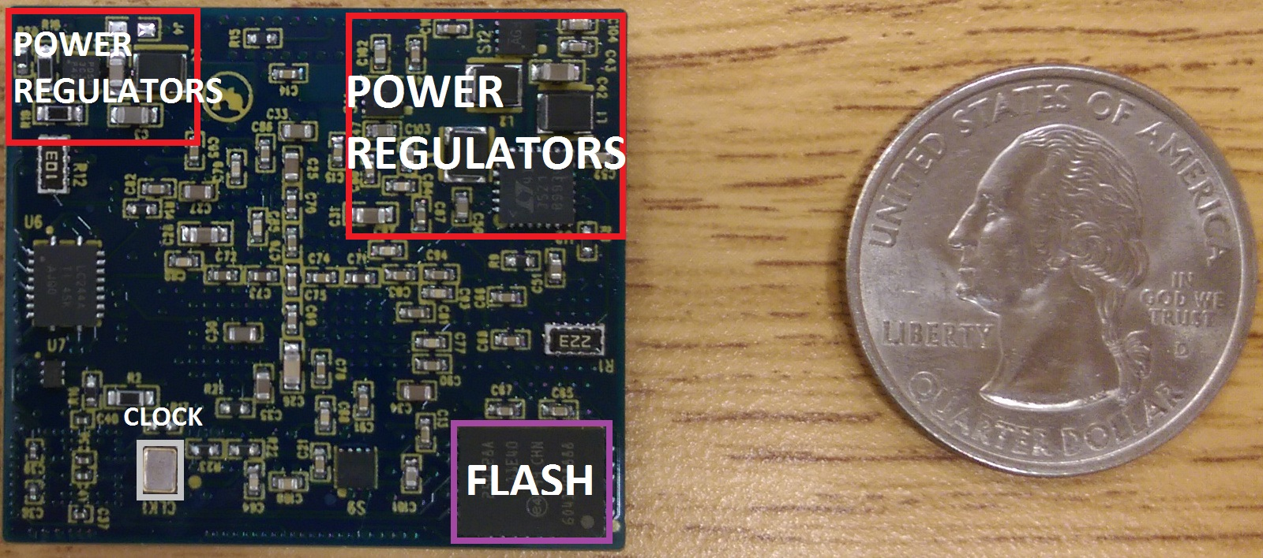
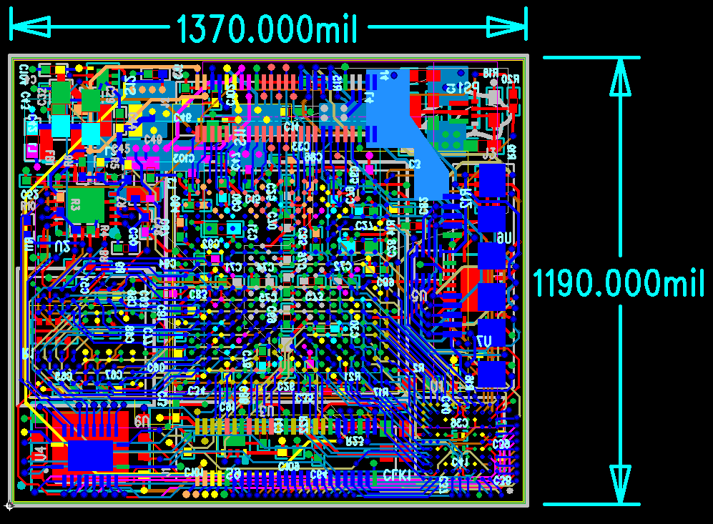
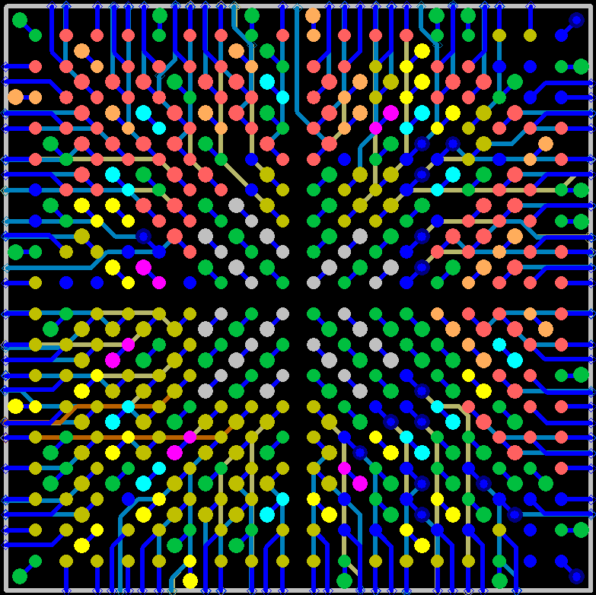
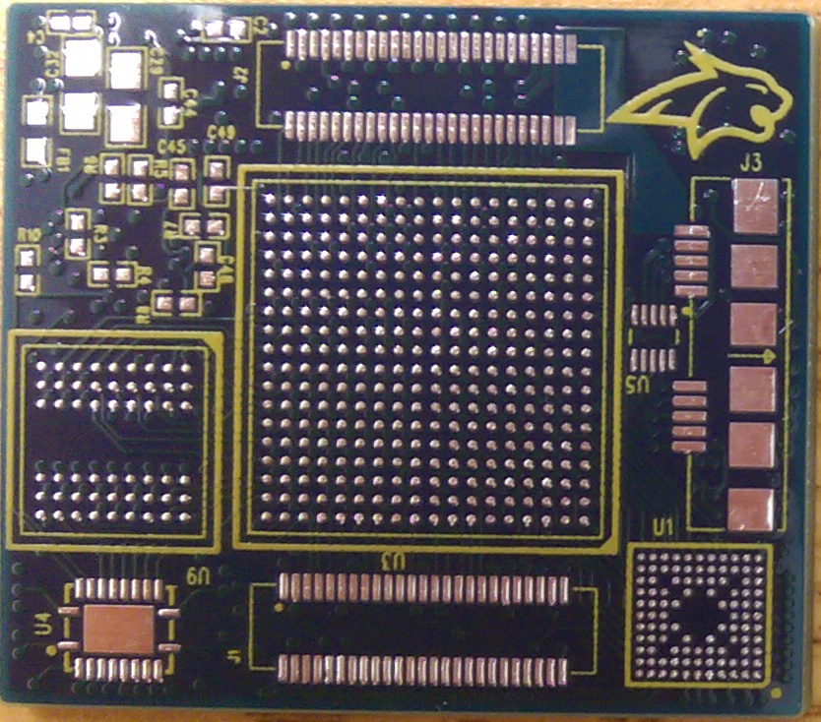
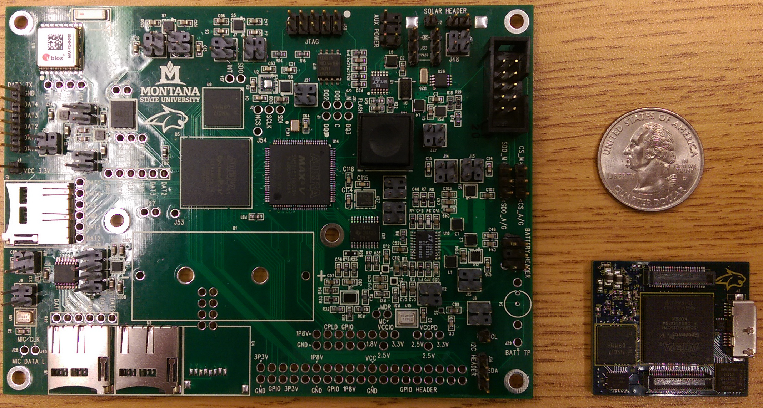
Printed Circuit Boards for the NSF Marmoset Collar Project
By: Kyler Callahan, Justin Marquart
Sponsored by National Science Foundation & Dr. Snider, Advised by Dr. Snider.
Project Goal
PCB Results
PCB Architecture
The goal of this project was to create printed circuit boards (PCBs) to connect the electronics for an observation collar for a marmoset monkey. The collar will record various sensory data such as acoustic data to monitor animal vocalizations, global position via GPS, and local movement from an inertial measurement unit (IMU). It will then store this data to a microSD card.
Top View of FPGA PCB
47 Unique Parts
24 Total parts on top
95 total parts on bottom
435 drill holes
650 total connections
10 layers
1.66 square inches
Bottom View of FPGA PCB
Objectives
One of the biggest challenges of the PCB design was working with Ball Grid Array (BGA) packages. These packages allow for a high number of pins to be put in a small area. However, because of their physical layout, they are difficult to work with when laying out traces under the packages.
BGA packages require 2 signals layers for the first 4 rows and an additional signal layer for every internal row after that. Our particular package took 4 signal layers to “break out”.
Build a printed circuit board that will power and run a Cyclone V FPGA as well as a MAX V CPLD
Make design be able to interface with a future peripheral board
Make design as small as possible
System architecture for the FPGA PCB design
PCB Design
Size constraints were a large part of the design since it needed to be as small a possible. To adhere to this size constraint the project needed to be split up into two parts that would be implemented on two separate PCBs. These PCBs will stack on top of each other to reduce lateral area. One PCB houses the FPGA and all associated circuitry, while the second PCB houses the sensors and storage devices.
Due to time constraints and evolving requirements for sensors, the FPGA PCB was the primary focus of this project. Because of this the FPGA PCB was designed so that it could interface with a variety of different daughter cards. The system gets power, and is able to be programmed from a single custom USB plug on the board, but can also receive those from a separate boards if need be.
BGA “breakout” pattern
An unpopulated board. Notice the 3 different BGA packages
Physical dimensions and connections of the design. 1 mil = 0.001 inches.
Previous Designs
Conclusion
A prototype development board for the project was created to initially test the design, as well as to monitor power consumption of all active devices. The board on the left is a fully featured design with all the necessary sensory equipment and debugging features.
The PCBs have been tested and are functional. The FPGA PCB has a small form factor allowing it to fit on a monkey. The board is fully programmable as a standalone design. Future work will be to create custom daughter boards that will house all sensor devices, a microSD card, and power management circuitry.

